Slide 1


Vingine
Search deep inside
A blazingly fast 🚀🚀 media search engine (as a service 🔥)

Slide 2
The team
Ahmed Ibrahim
Ahmed Sayed
Nadeen Ayman
Omer Yacine
Supervised by Dr. AbdelMoniem Bayomi

Slide 3
Table of contents
01
05
02
06
03
07
04
08
Market & Competi3tors
Topic Segmentation
Our Product
Scene Segmentation
System Architecture
Scene Description
ASR
Work Division & Future Work

Slide 4
01
Market & Competitors

Slide 5
Market
Social media platforms
Courses and education sector
Your very personal public media library
Notes:
Facebook
Coursera, udemy
Prisma library,
etc…

Slide 6


Competitors
YouTube
VIDIZMO

Slide 7
YouTube
Us
Indexes subtitles.
Indexes visual features.
Doesn’t incorporate timestamps in the search result.
Not open source nor a portable service.
Indexes auto generated subtitles and scene description along with the timestamps thus allowing partial retrievals.
Built as a service.

Slide 8
VIDIZMO
Us
Is an enterprise focused video serving/hosting platform.
Allows searching by subtitles text and *limited* visual descriptions of the videos uploaded on it.
Isn’t integratable with other platforms.
Indexes auto generated subtitles and scene description along with the timestamps thus allowing partial retrievals.
Built as a service.

Slide 9
02
Our Product

Slide 10
Our product
Audio
Scenes
Auto generates indexable text from audio in the content
Splits the video based on visual features, each segment considered as one visually coherent unit
Topics
Description
Splits the content into a bunch of chapters/topics each of which are searchable on it’s own
Understands what’s the scene is about and describes it

Slide 11
03
System Architecture

Slide 12

System architecture

Slide 13
04
Automatic Speech Recognition

Slide 14
Automatic Speech Recognition
We need to auto-generate transcripts for the provided videos.
This can be done by :
Having vector representation of speech signal
Map these vectors to subwords
Collecting subwords into words

Slide 15
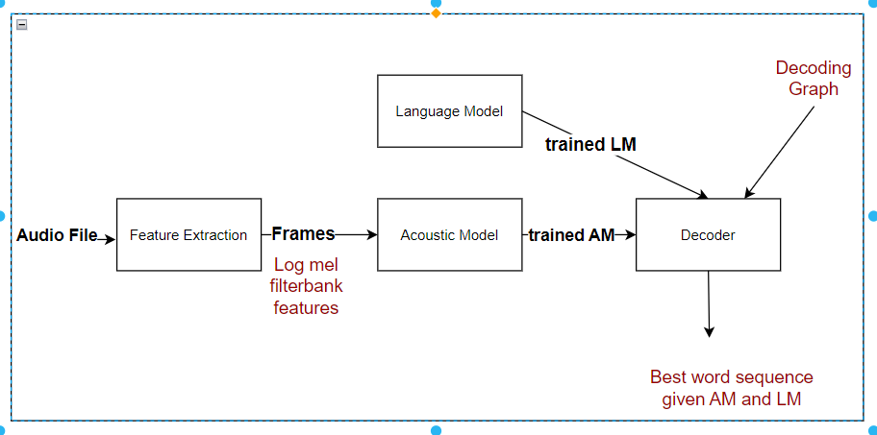
ASR Overview

Slide 16
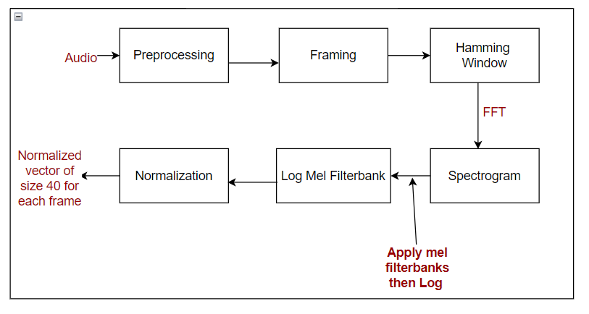
Feature Extraction

Slide 17
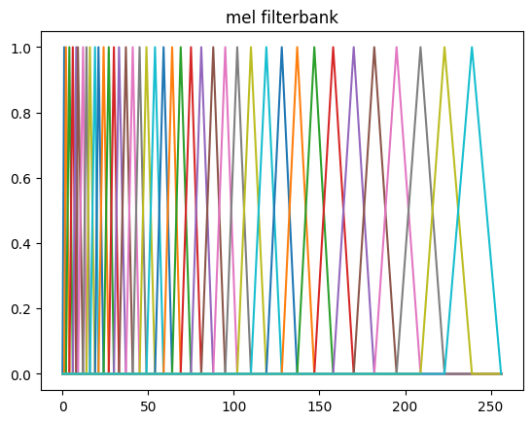
Mel Filterbanks
(Traingular Filters)

Slide 18
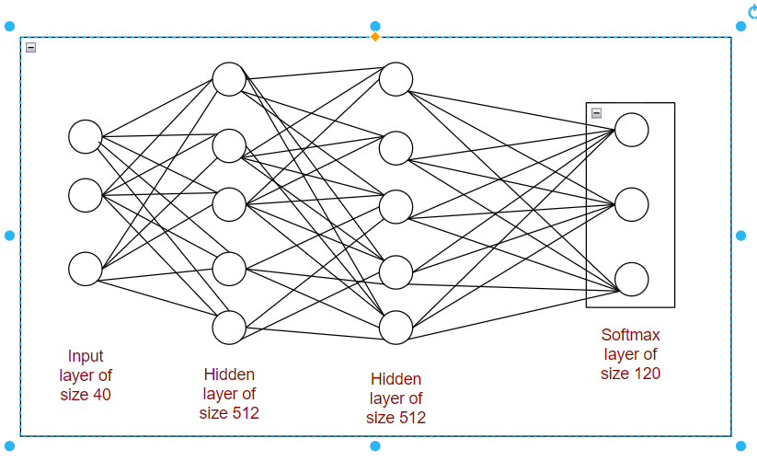
Acoustic Model

Slide 19
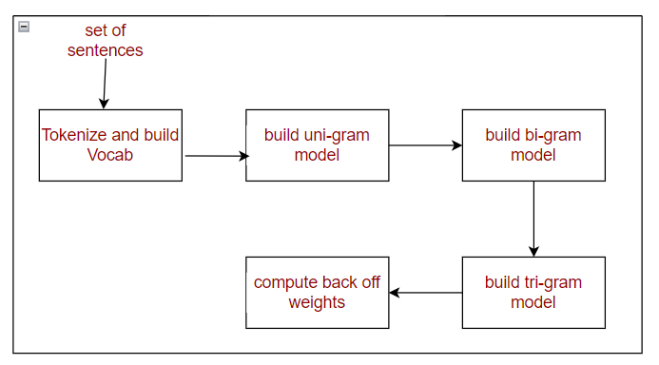
Language Model
Probabilistic model that calculates the probability of any sequence of words
It must give high probability to grammatically correct sentences

Slide 20
Language Model
Problem of sequences that never appeared in the training corpus ?
Smoothing
Moving some of the probability mass from seen data into unseen data.
P(wk|w1. . . wk-1)=c(w₁ ...wk) + 1 / [(c(w₁...wk-1)+ |V| ]
Compute Backoff probabilities
P(wk|w1. . . wk-1)= P(wk|w₁. . . wk-1), if c(w1…..wk) > 0
bow(w1….wk-1) * P(wk|w2. . . wk-1), if c(w1…..wk) = 0

Slide 21
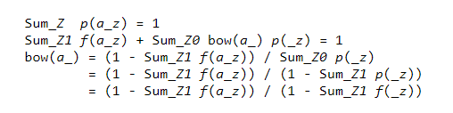
Backoff weight calculations
Used to redistribute the probability mass from higher-order-n-grams to lower-order-n-grams

Slide 22
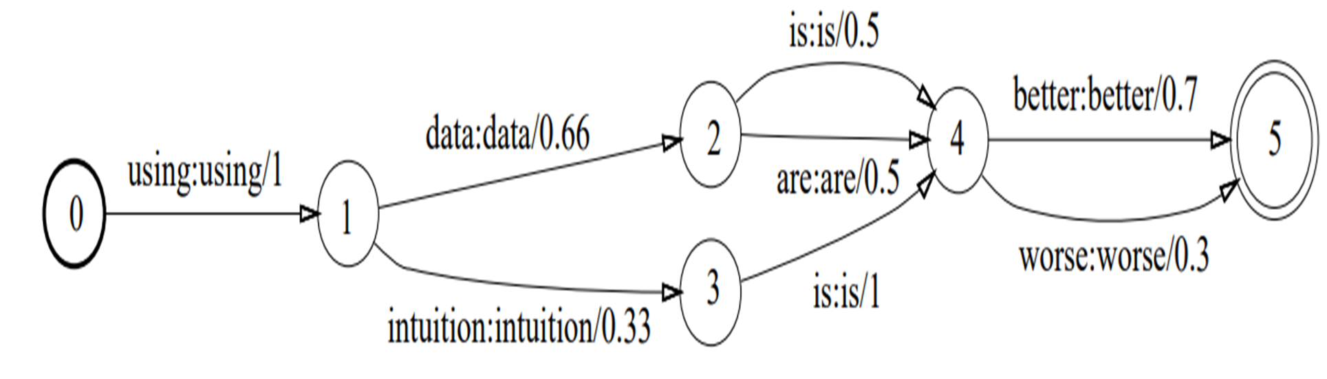
Language Model Usage In ASR

Slide 23
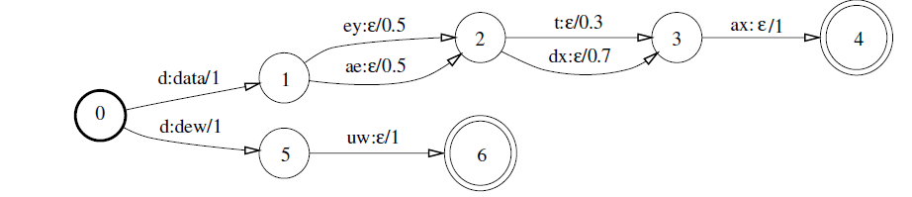
Decoding Graph
The language model graph which is called G-graph is composed with the HCL-graph to form what is called HCLG-graph which is passed to the decoder to find the best sequence of words given sequence of subphones.

Slide 24
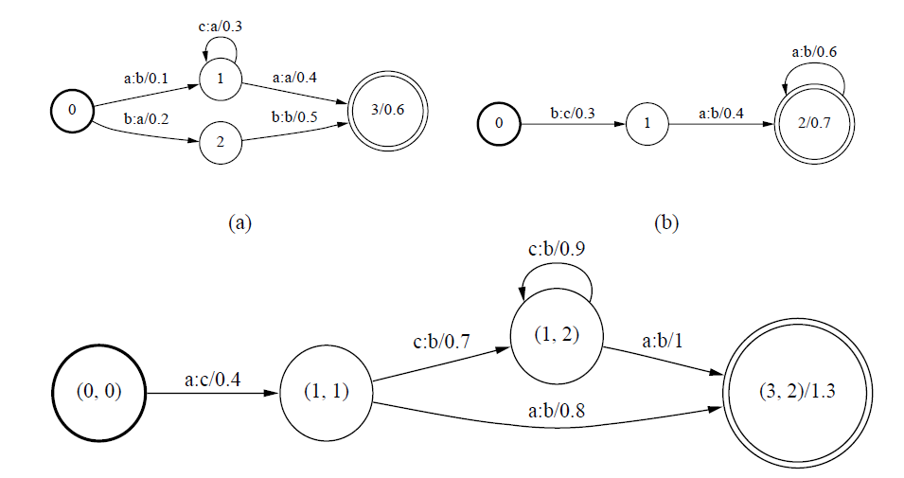
Graph Composition

Slide 25
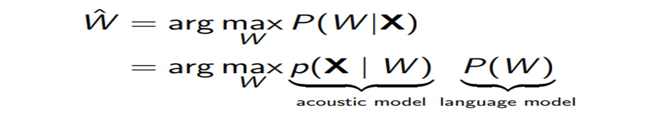
Decoder
This module is responsible for solving the following HMM decoding problem:

Slide 26
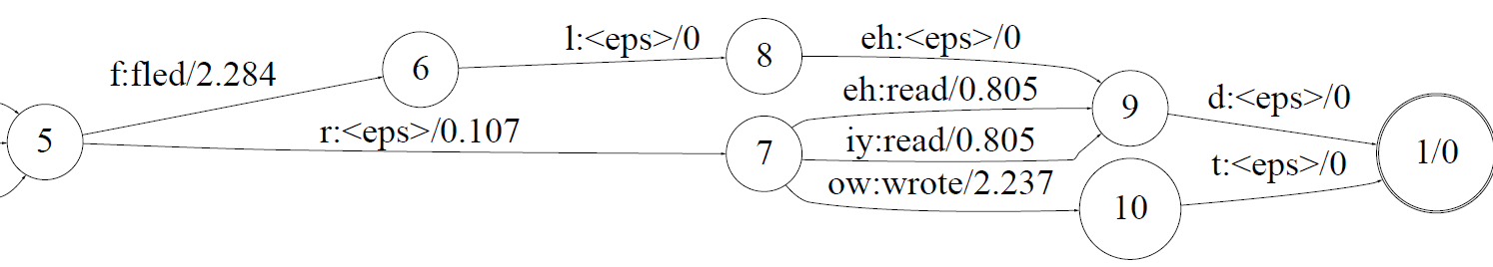
Decoder Beam Search

Slide 27
05
Topic Segmentation

Slide 28
Topic Segmentation
We need to split the ASR output into coherent topics/chapters.
There were no dataset aimed for topic segmentation of ASR output.
We used Wiki-727K dataset which consists of English Wikipedia articles with segmentation labels between different section.
By removing stop words, we made the dataset less coherent and more resembling of an ASR output, thus, could be used to train our model for that task.
We used a 2-level transformer architecture to capture the topic change and point on the sentence where the topic changed.

Slide 29
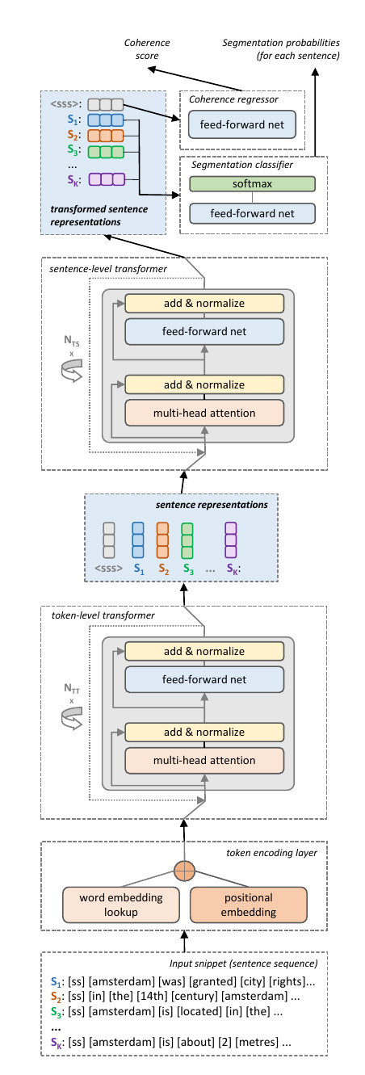
Two Level Transformer

Slide 30
06
Scene Segmentation

Slide 31
Scene Segmentation
We first performed shot detection using simple visual features (HoG, HSV Hist, etc…) to get the shot boundary frames.
Implemented Optimal Sequential Grouping using low and high level features to find the optimal scene boundaries, which involve using Dynamic Programming.
Cost Functions:
Add Cost
Norm Cost

Slide 32
Optimal sequential groupingion
Define features for shots
Declare the relation between clustering and OSG , and the Difference between them
Define objective function
Define subproblem
Implement dynamic programming problem

Slide 33
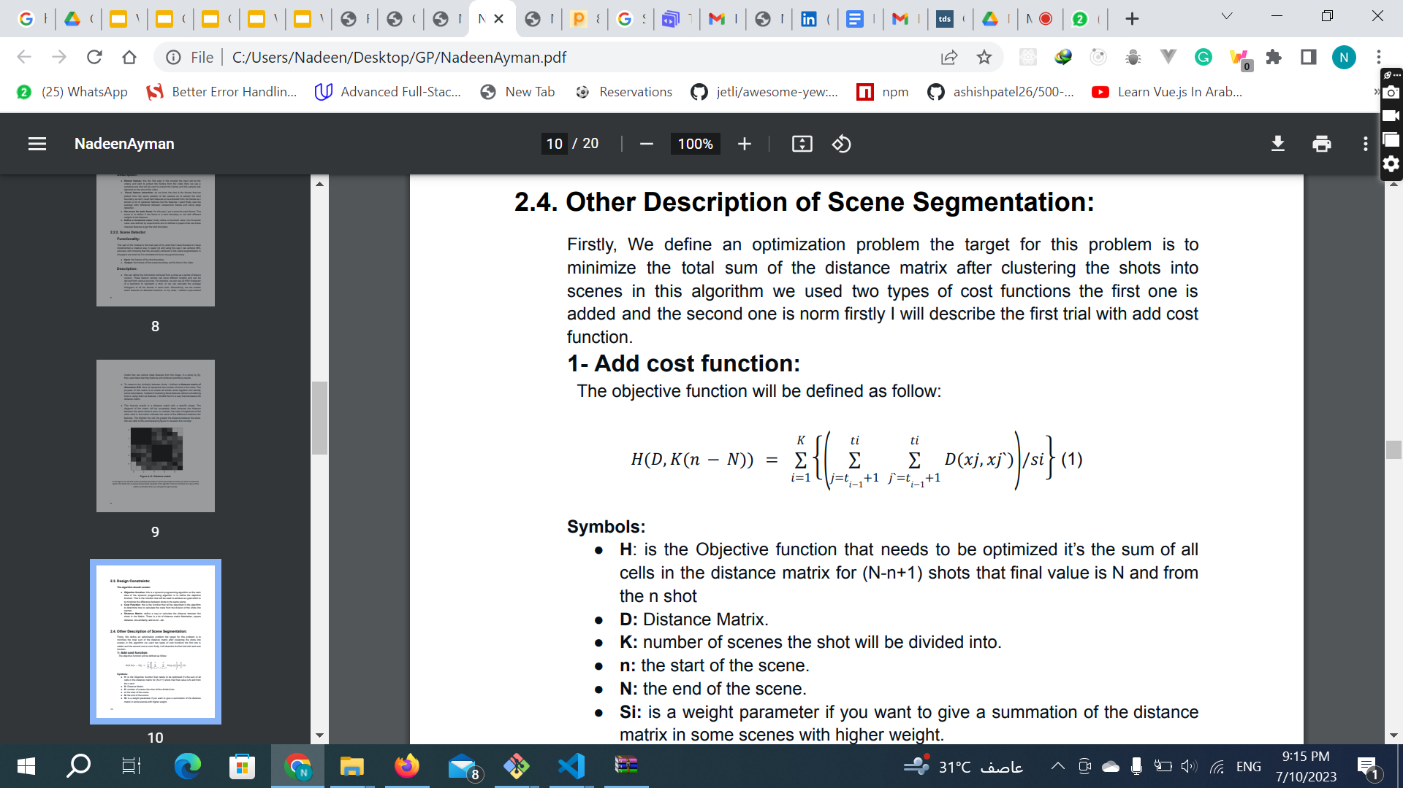
1- Add cost function

Slide 34
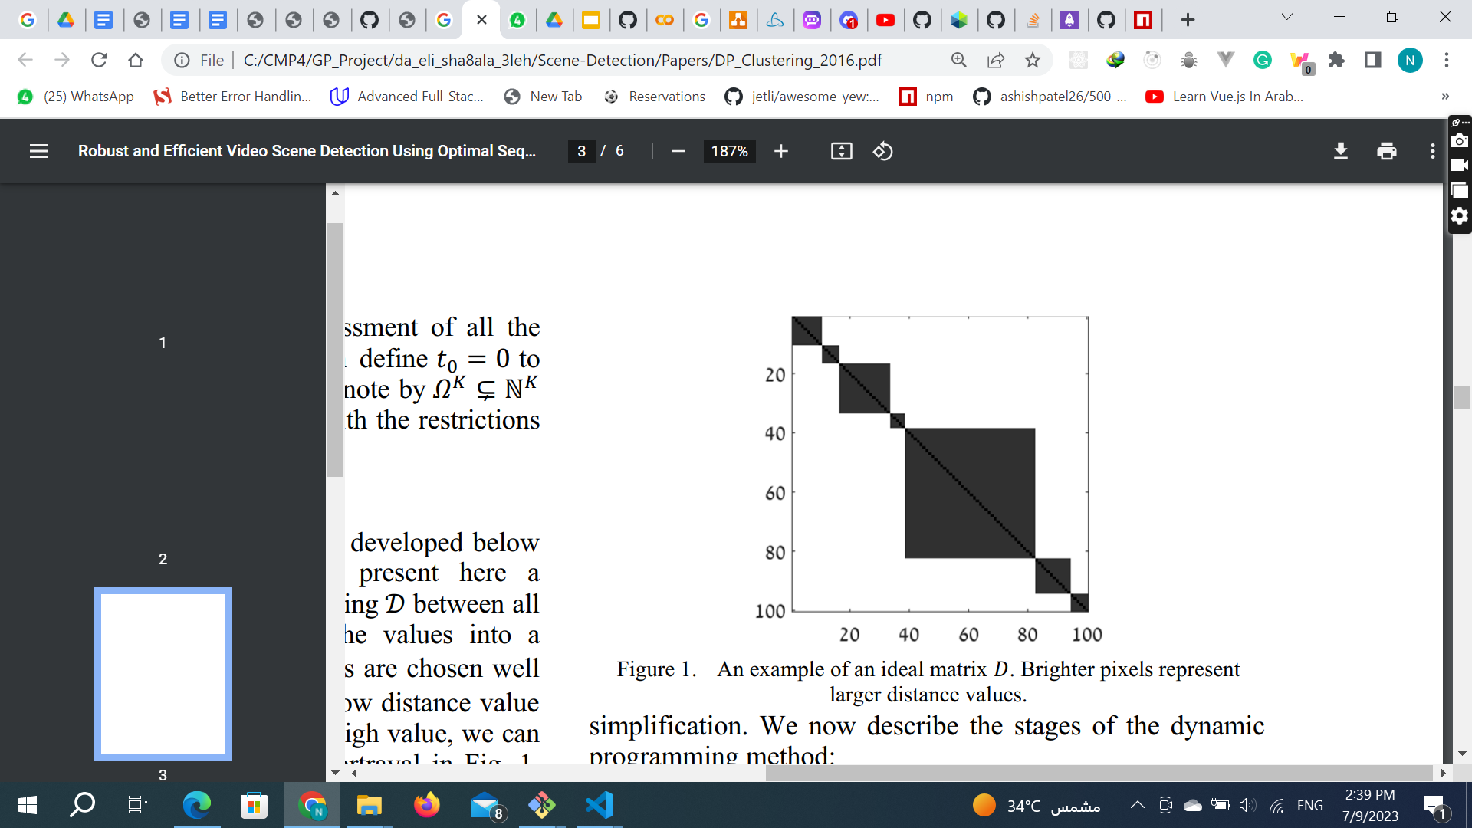
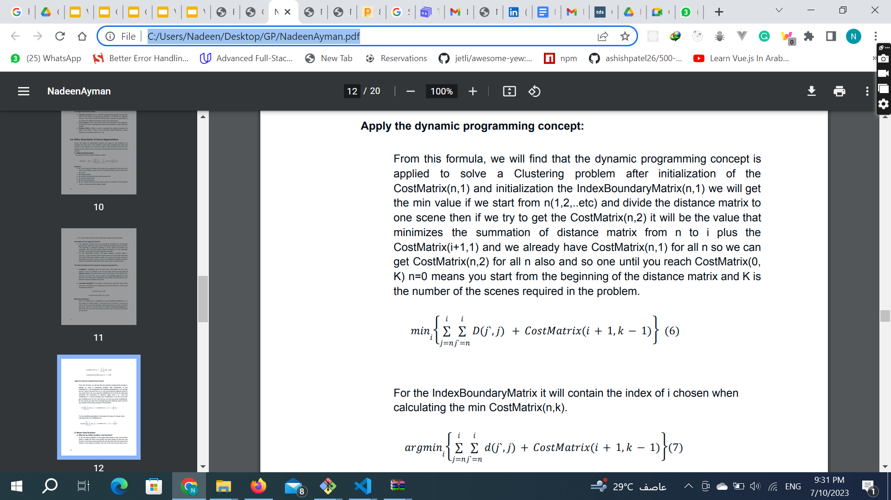
1- Apply Dynamic programming

Slide 35
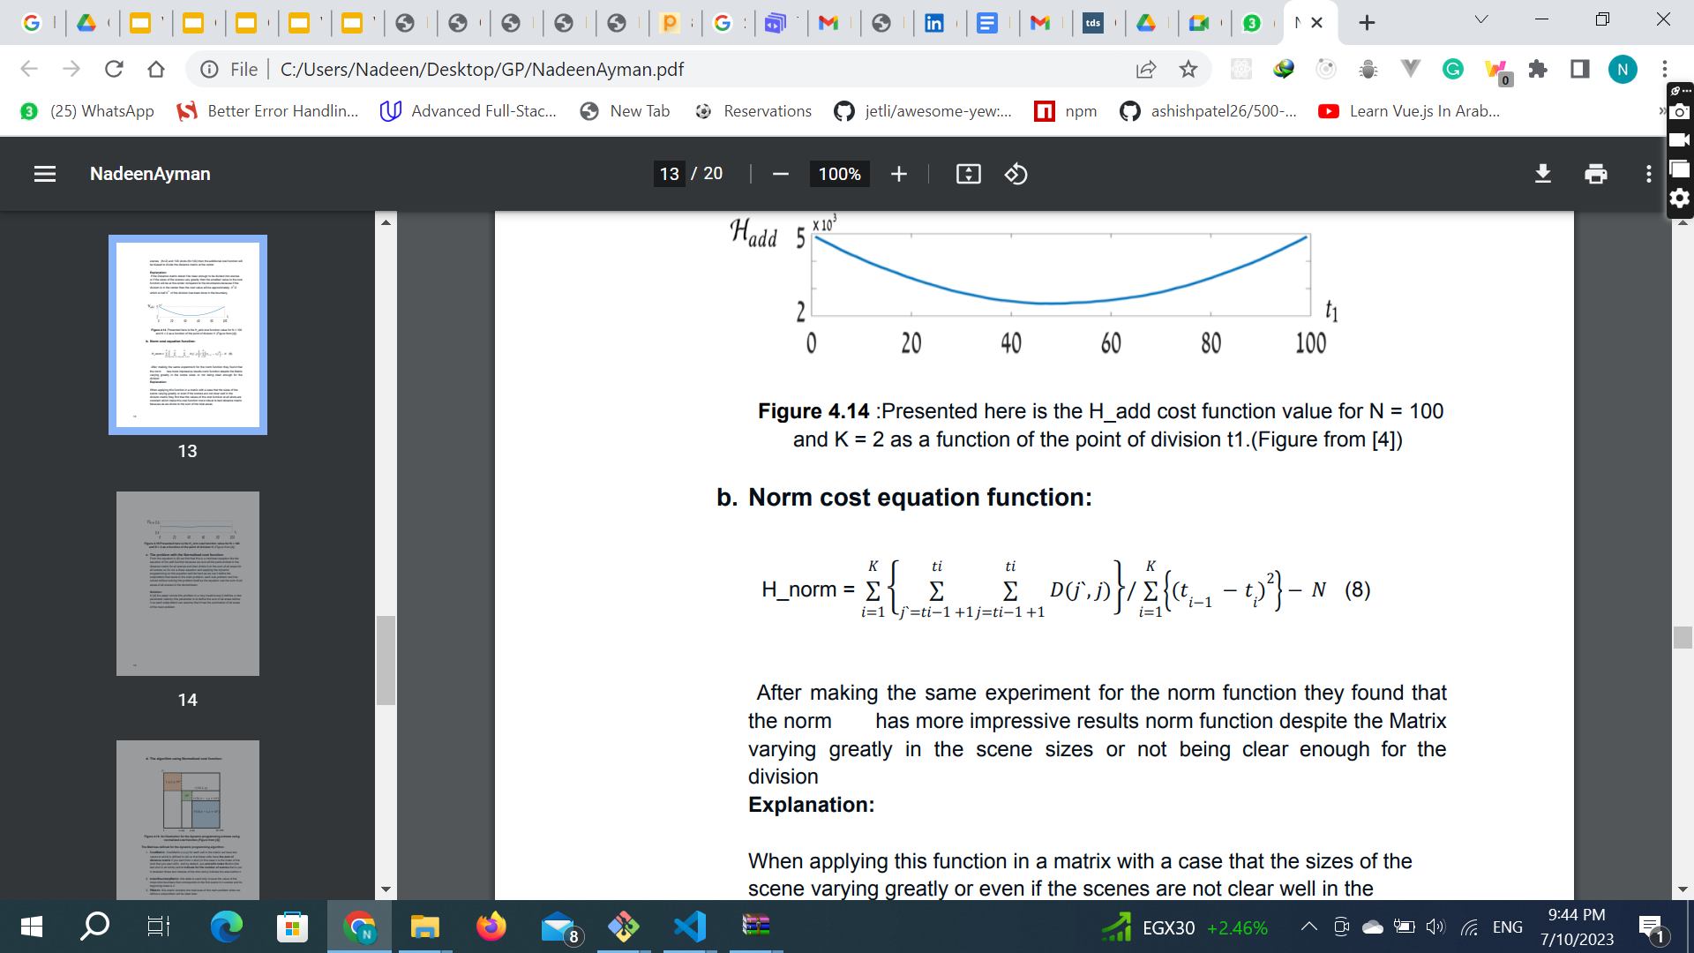
1- Norm cost function

Slide 36
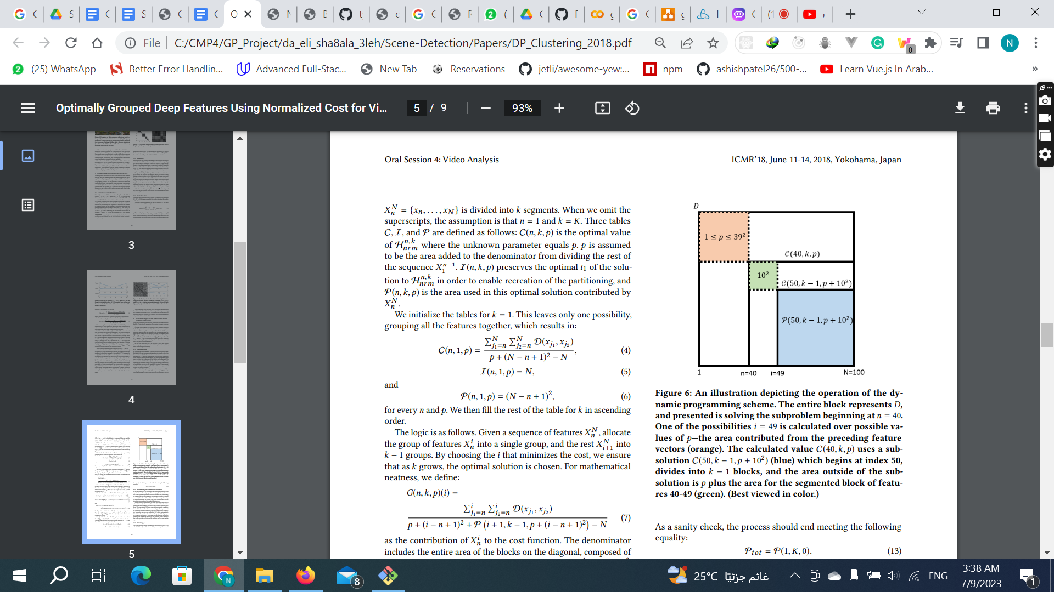
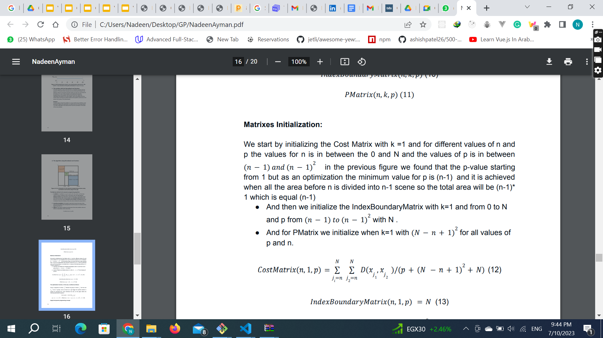
2- Norm cost function

Slide 37
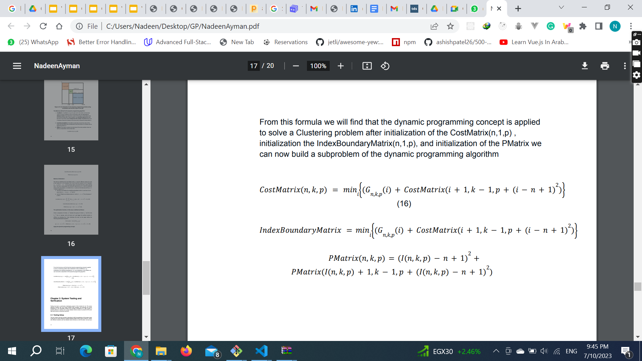
1- Apply Dynamic programming

Slide 38
07
Scene Description

Slide 39
Scene Description
We need to describe a scene with text.
We used S3D to find the actions performed in the scene trained on Kinetics 400 dataset.
We used Faster R-CNN to get the objects found in the scene.
We used VRD to get the relationship between objects in the scene.
We also used a ready made OCR (easyocr) to get any textual information in the scene.

Slide 40
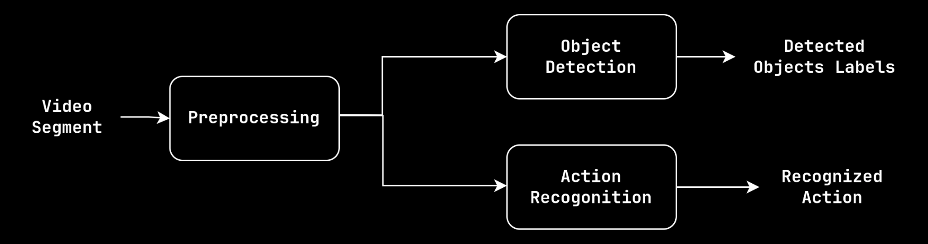
Scene Description

Slide 41
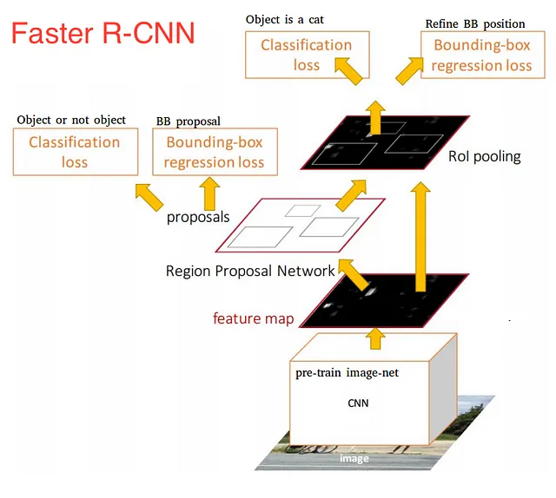
Object Detection
Notes:
Illustrating how Faster R-CNN works on a high-level. Source: https://towardsdatascience.com/deep-learning-for-object-detection-a-comprehensive-review-73930816d8d9

Slide 42
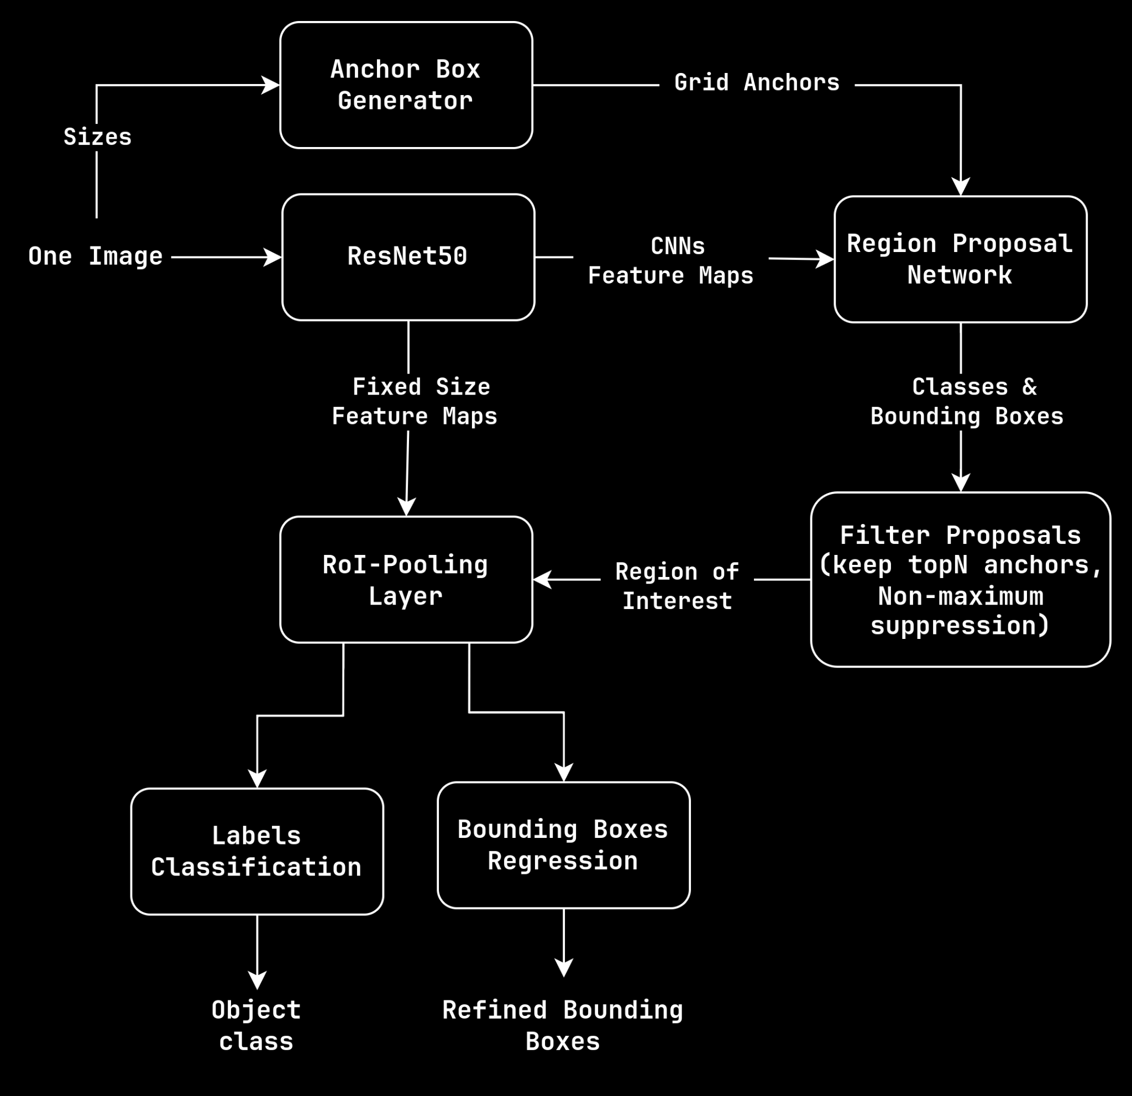
Scene Description

Slide 43
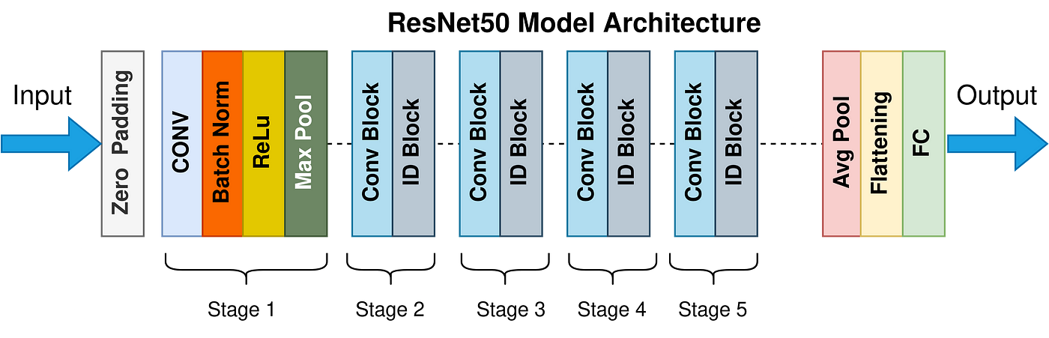
ResNet: Architecture
Notes:
Diagram shows how those anchors are generated. Source: https://www.telesens.co/2018/03/11/object-detection-and-classification-using-r-cnns/

Slide 44
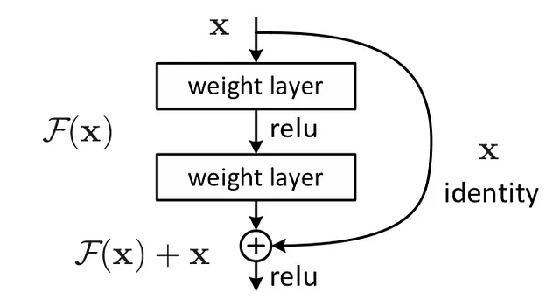
Residual Learning
- Building block in ResNets
- Allows the information flow from one layer to another easily through Skip Connection
- Identity Blocks used if input & output dims are the same.
- Convolutional Block helps when they’re different
Notes:
Figure Showing Residual Block Structure. Source: https://medium.com/analytics-vidhya/understanding-and-implementation-of-residual-networks-resnets-b80f9a507b9c

Slide 45
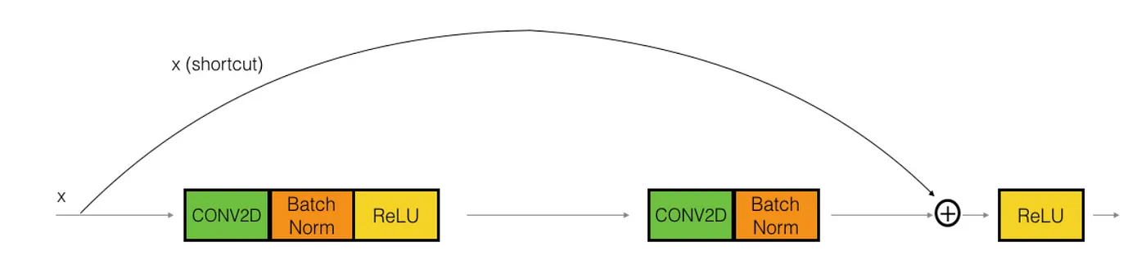
Identity Blocks
simply bypassing the input volume to the addition operator
Notes:
Figure Showing Residual Block Structure. Source: https://medium.com/analytics-vidhya/understanding-and-implementation-of-residual-networks-resnets-b80f9a507b9c

Slide 46
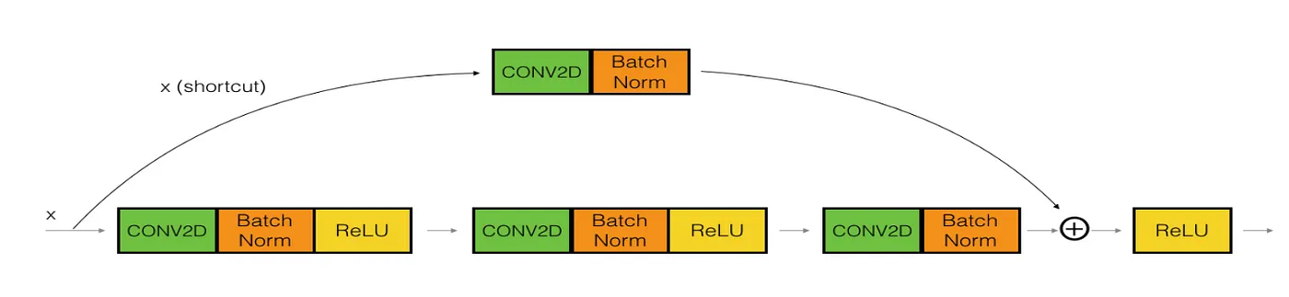
Convolution Block
Performs a Conv operation to ensure the volumes at addition operation are the same size.
Notes:
Figure Showing Residual Block Structure. Source: https://medium.com/analytics-vidhya/understanding-and-implementation-of-residual-networks-resnets-b80f9a507b9c

Slide 47
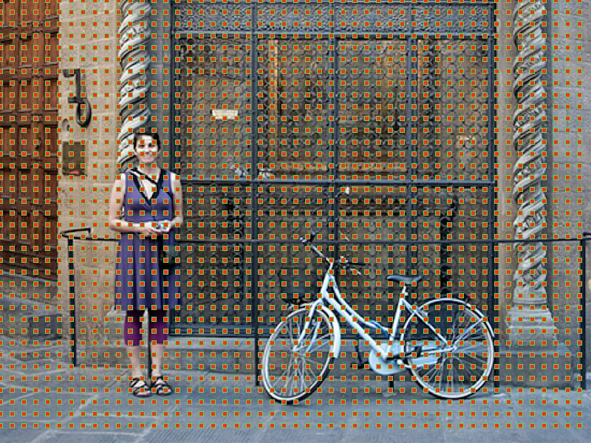
Anchor Boxes
Notes:
Diagram shows how those anchors are generated. Source: https://tryolabs.com/blog/2018/01/18/faster-r-cnn-down-the-rabbit-hole-of-modern-object-detection

Slide 48
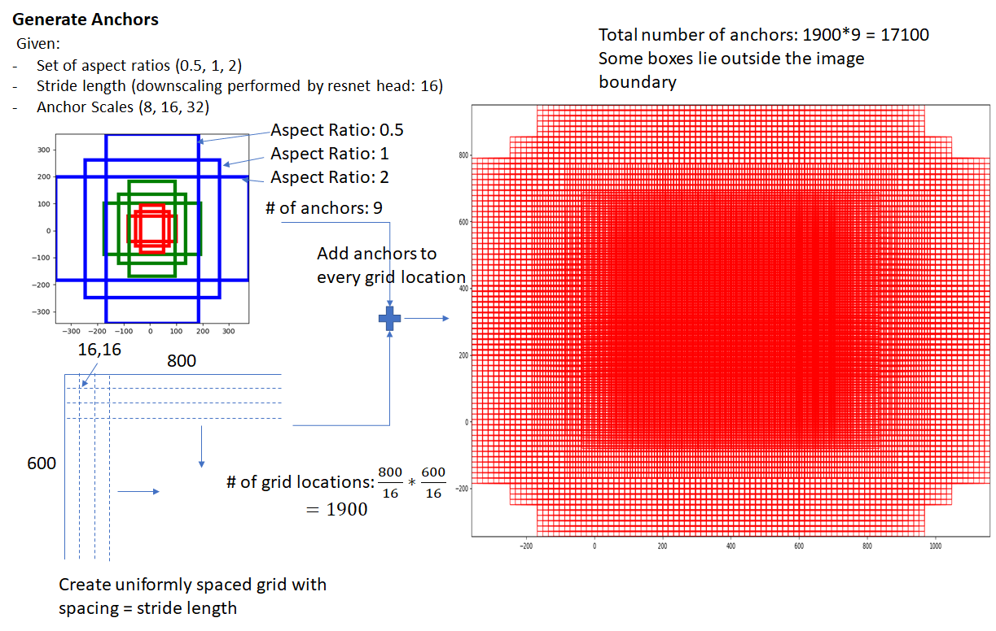
Anchor Boxes
Notes:
Diagram shows how those anchors are generated. Source: https://www.telesens.co/2018/03/11/object-detection-and-classification-using-r-cnns/

Slide 49
RPN
- Filter proposals: a) Remove small boxes
b) Remove boxes outside the Images boundary
c) Apply Non-Maximum Suppression to remove redundant boxes
- Outputs: (4+2)*K+(W*H)
a) Score the object of being a background or foreground 2K
b) Object bounding boxes regressors 4K
Notes:
Figure show how the RPNHead part works Source: https://www.telesens.co/2018/03/11/object-detection-and-classification-using-r-cnns/

Slide 50
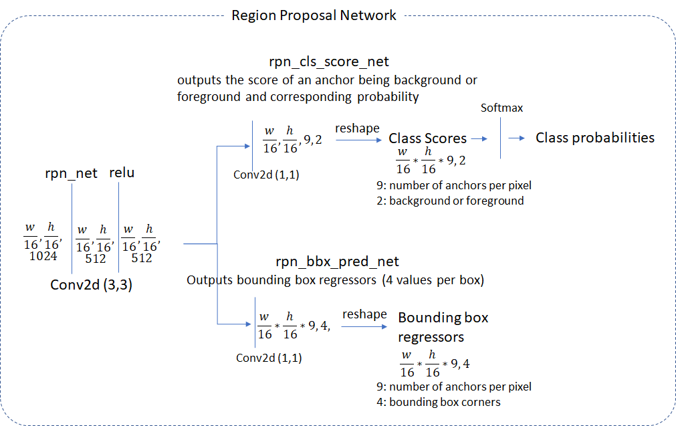
RPN
Notes:
Figure show how the RPNHead part works Source: https://www.telesens.co/2018/03/11/object-detection-and-classification-using-r-cnns/

Slide 51
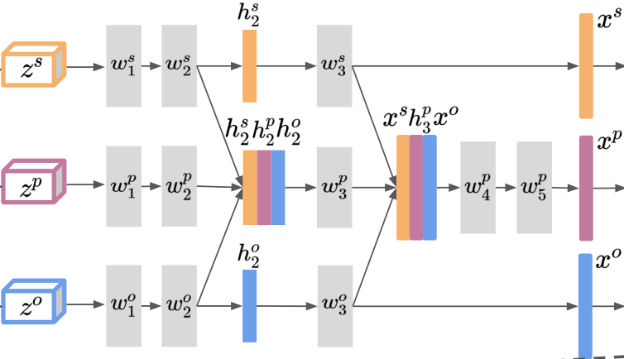
RelDN
Notes:
Figure shows how the relation detection network works. Source: https://arxiv.org/pdf/1804.10660

Slide 52
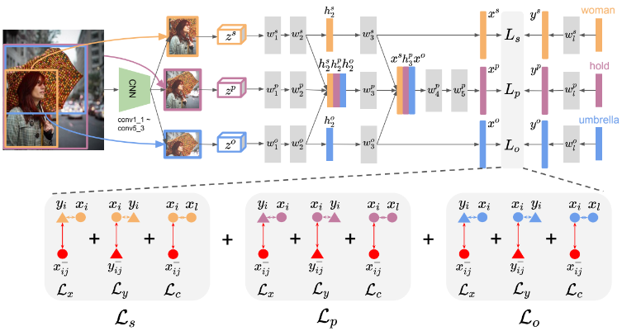
RelDN
Notes:
Figure shows how the relation detection network works. Source: https://arxiv.org/pdf/1804.10660

Slide 53
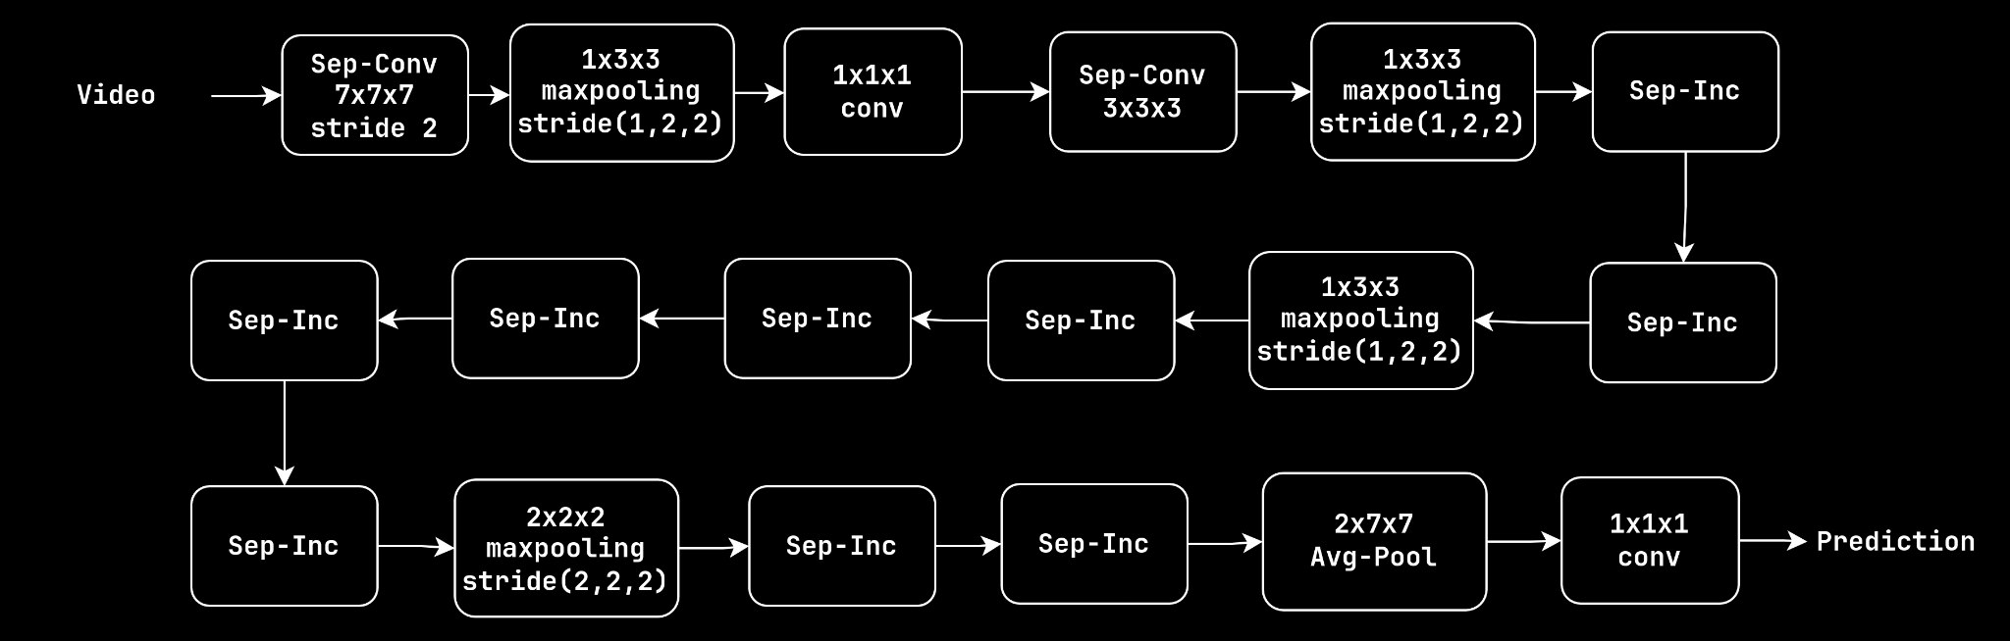
Action Recognition

Slide 54
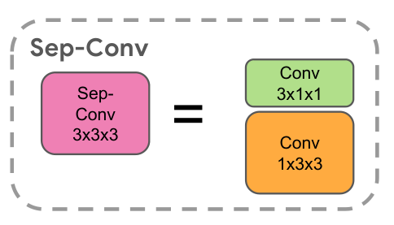
Sep-Conv
Separating spatial & temporal convolutions results in:
- Compression in model size from 12.06M parameters to 8.77M parameters.
- Large speed up 107.9 GFLOPS for I3D reduced to
66.38 GFLOPS for S3D
Notes:
Sep-Conv Block. Source: http://arxiv.org/pdf/1712.04851

Slide 55

Images Variations
Notes:
Image from https://unsplash.com/

Slide 56
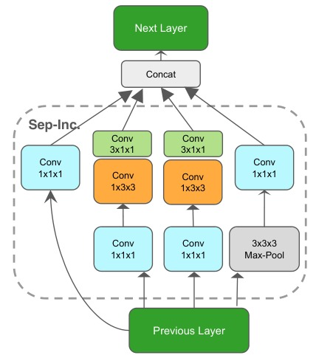
Inception Block
- Problem: Huge variations in Images needs multiple kernel sizes to match local and global changes
- Having very deep network is prone to overfitting and computationally expensive
- Solution: getting the network more wider not deeper
Notes:
Incepiton Block. Source: http://arxiv.org/pdf/1712.04851

Slide 57
1x1x1 Conv.
Input Feature Map: 28x28x192
- 5x5x32 filters results in 24x24x32 by applying 120.422 Million operations
- However, having 1x1x16 filters => 28x28x 16
Then having 5x5x32 filters => 24x24x32 but with only
12.4 Million operations
Reduction by a factor of 10 !
Notes:
Inception Block. Source: http://arxiv.org/pdf/1712.04851
—-------------
Max-pooling:
- Downscaling Image by extracting most important feature
which reduce the computations needed in further layers
- Removing Invariances like shift, rotational and scale
—-------------

Slide 58
Service Integration
Each scene/topic/chapter had one entry in our index, storing the start & end time and the searchable text content found in this scene.
We describe the scene visually every 5 seconds, to generate a structured description that allows the user to seek exactly to the point where an action was performed/object appeared.
We dump the output of each 5 seconds into their corresponding index entry as per scene segmentation splits.

Slide 59
08
Future Work & Work Division

Slide 60
Future work
Support indexing in multiple languages.
Improve the accuracy of our video description module with the latest findings in this research field.
Support for searching non-text based content (like melodies da da da dn dan).
Explore vectorization options.

Slide 61
Work Division
 | Ahmed Sayed 25% | Omar Yacine 25% | Nadeen Ayman 25% | Ahmed Ibrahim 25% | Ready made
Module 1 (ASR) | 25% | 0 | 0 | 0 | 5%
Module 2 (Topic Seg) | 0 | 25% | 0 | 0 | 0%
Module 3 (Scene Seg) | 0 | 0 | 25% | 0 | 3%
Module 4 (Scene Desc) | 0 | 0 | 0 | 25% | 10%

Slide 62

Thanks!
Questions?
Notes:
Any questions?

Slide 63
Demo @ Vingine.me
Try Searching For:
Passing Football, Shaving Head, Using Keyboard, Crawling Baby, Cocaine, Language Learning, Scrambling Eggs, Horse Riding, Cliff
Notes:
Any questions?

Slide 64
Thanks!
Reach out to us:
ahmed.mostafa00@eng-st.cu.edu.eg
ahmed.abdalghany00@eng-st.cu.edu.eg
nadeen.ali00@eng-st.cu.edu.eg
omar.yassin00@eng-st.cu.edu.eg
Notes:
Any questions?

Slide 65
attribution
Template from SlidesGo

